Slide 1
Azure Security Posture

Slide 2
Agenda
A Modern Enterprise
Challenges Faced
Need for Azure Governance
The Governance Scaffolding
Understand the Security Landscape
Components of Azure Security Model
Unified Security Management - Azure Security Center
Unified Visibility
Advanced Threat Prevention
Intelligent Detection & Response
Security Implementation Process

Slide 3

The Modern Enterprise
Azure Active Directory
Rights Management Services
Key Management Services
PaaS
IaaS
3rd Party IaaS
Office 365
Microsoft Azure
Admin Environment
3rd Party SaaS
High Value Assets
On-Premises Datacenters
Customer and Partner Access
Branch Office
Intranet and Remote PCs
Mobile Devices

Slide 4
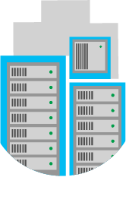
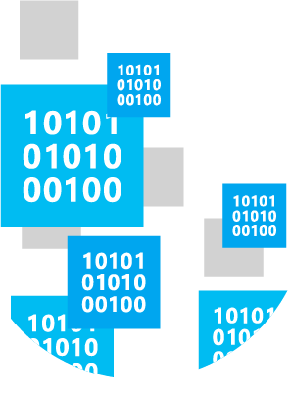
Challenges
$
$
$
$
$
$
$
$
$
$
$
$
$
$
Management is increasingly distributed
Cloud environments are more dynamic
A new approach is required

Slide 5
Challenges
Lack of Visibility
Lack of Control
Cost Overshoot
Non-Compliance
Security Risks
Notes:
Business units within organizations are early adopters
As they see the advantages of cloud computing services.
Sales & marketing to HR & supply chain
they are adopting the cloud with or without IT’s help.
When business functions adopt the cloud without IT’s involvement, the organization often ends up with
multiple business units contracting with multiple vendors
Do not understanding the risks or requirements.
At the same time, IT lacks the visibility to efficiently and effectively manage these disparate cloud environments, creating
unnecessary complexity &
cost for the organization.
Consider the example of a Marketing Department
The ease of deploying and scaling cloud services, along with their low cost of acquisition, has resulted in
helping the organizations to become more agile,
the inability to track and control provisioning of the resources incurs an unaccountable cloud spend.
increasingly decentralized IT, or what is referred to as “shadow IT.”
Consider the example of a Marketing Department
In a cloud environment, there is a principal-agent relationship:
the cloud service consumer is the principal and
the cloud service provider are the agent.
When operational control is released from the principal and delegated to the agent (e.g., outsourced),
a mechanism is required to minimize risks and costs.
Contracts among business parties often restrict how data is used and who is authorized to access it.
When employees move restricted data into the cloud without authorization, the business contracts may be violated, and legal action could ensue.
Consider the example of a cloud service that maintains the right to share all data uploaded to the service with third parties in its terms and conditions,
thereby breaching a confidentiality agreement the company has made with a business partner.
Most companies operate under some sort of regulatory control of their information,
whether it’s HIPAA for private health information,
FERPA for confidential student records, or one of many other government and industry regulations.
Under these mandates, companies must know
where their data is,
who is able to access it, and
how it is being protected.
BYOC often violates every one of the above tenets, putting the organization in a state of non-compliance, which can have serious repercussions.
Loss or theft of intellectual property
Companies increasingly store sensitive data in the cloud. An analysis by Skyhigh found that 21% of files uploaded to cloud-based file sharing services contain sensitive data including intellectual property. When a cloud service is breached, cyber criminals can gain access to this sensitive data. Absent a breach, certain services can even pose a risk if their terms and conditions claim ownership of the data uploaded to them.
Compliance violations and regulatory actions
These days, most companies operate under some sort of regulatory control of their information, whether it’s HIPAA for private health information, FERPA for confidential student records, or one of many other government and industry regulations. Under these mandates, companies must know where their data is, who is able to access it, and how it is being protected. BYOC often violates every one of these tenets, putting the organization in a state of non-compliance, which can have serious repercussions.
Loss of control over end user actions
When companies are in the dark about workers using cloud services, those employees can be doing just about anything and no one would know—until it’s too late. For instance, a salesperson who is about to resign from the company could download a report of all customer contacts, upload the data to a personal cloud storage service, and then access that information once she is employed by a competitor. The preceding example is actually one of the more common insider threats today.
Malware infections that unleash a targeted attack
Cloud services can be used as a vector of data exfiltration. Skyhigh uncovered a novel data exfiltration technique whereby attackers encoded sensitive data into video files and uploaded them to YouTube. We’ve also detected malware that exfiltrates sensitive data via a private Twitter account 140 characters at a time. In the case of the Dyre malware variant, cyber criminals used file sharing services to deliver the malware to targets using phishing attacks.
Contractual breaches with customers or business partners
Contracts among business parties often restrict how data is used and who is authorized to access it. When employees move restricted data into the cloud without authorization, the business contracts may be violated and legal action could ensue. Consider the example of a cloud service that maintains the right to share all data uploaded to the service with third parties in its terms and conditions, thereby breaching a confidentiality agreement the company made with a business partner.
Diminished customer trust
Data breaches inevitably result in diminished trust by customers. In one of the larges breaches of payment card data ever, cyber criminals stole over 40 million customer credit and debit card numbers from Target. The breach led customers to stay away from Target stores, and led to a loss of business for the company, which ultimately impacted the company’s revenue. See number 9 below.
Data breach requiring disclosure and notification to victims
If sensitive or regulated data is put in the cloud and a breach occurs, the company may be required to disclose the breach and send notifications to potential victims. Certain regulations such as HIPAA and HITECH in the healthcare industry and the EU Data Protection Directive require these disclosures. Following legally-mandated breach disclosures, regulators can levy fines against a company and it’s not uncommon for consumers whose data was compromised to file lawsuits.
Increased customer churn
If customers even suspect that their data is not fully protected by enterprise-grade security controls, they may take their business elsewhere to a company they can trust. A growing chorus of critics are instructing consumers to avoid cloud companies who do not protect customer privacy.
Revenue losses
News of the Target data breach made headlines and many consumers stayed away from Target stores over the busy holiday season, leading to a 46% drop in the company’s quarterly profit. The company estimated the breach ultimate cost $148 million. As a result, the CIO and CEO resigned and many are now calling for increased oversight by the board of directors over cyber security programs.
According to the Ponemon BYOC study, a majority (64 percent) of respondents say their companies can’t confirm if their employees are using their own cloud in the workplace. Trust us—they are. In order to reduce the risks of unmanaged cloud usage, companies first need visibility into the cloud services in use by their employees. They need to understand what data is being uploaded to which cloud services and by whom. With this information, IT teams can begin to enforce corporate data security, compliance, and governance policies to protect corporate data in the cloud. The cloud is here to stay, and companies must balance the risks of cloud services with the clear benefits they bring.

Slide 6
Cloud Adoption Journey
Cloud Adoption Framework

Slide 7
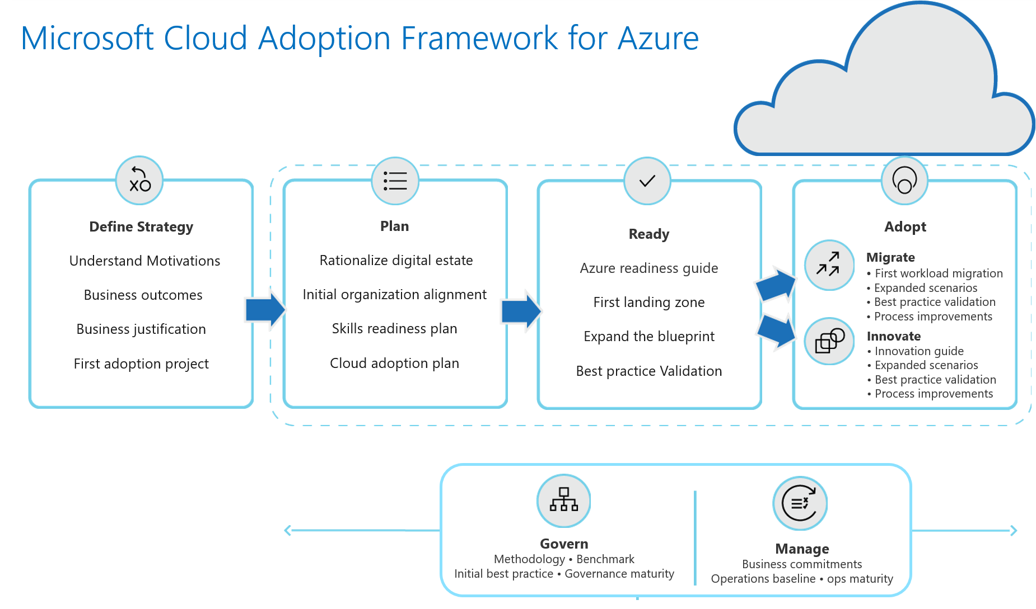
Cloud Adoption Framework

Slide 8
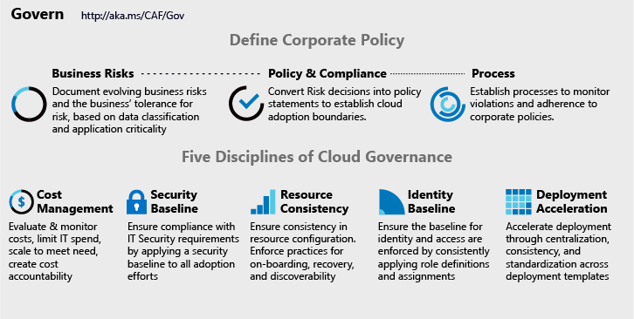
Model for Establishing an End State

Slide 9
The Scaffolding
Azure Governance Scaffolding

Slide 10
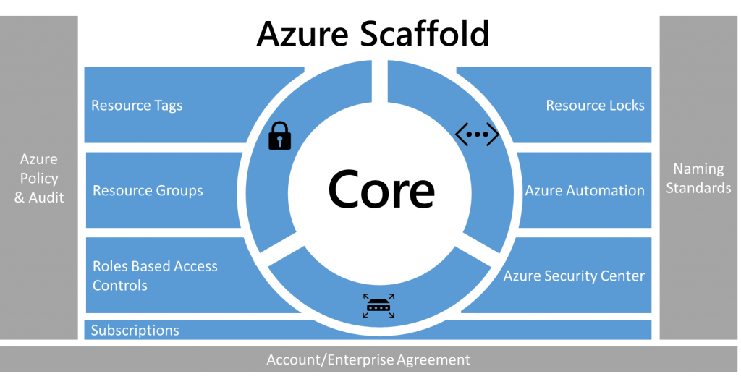

Slide 11
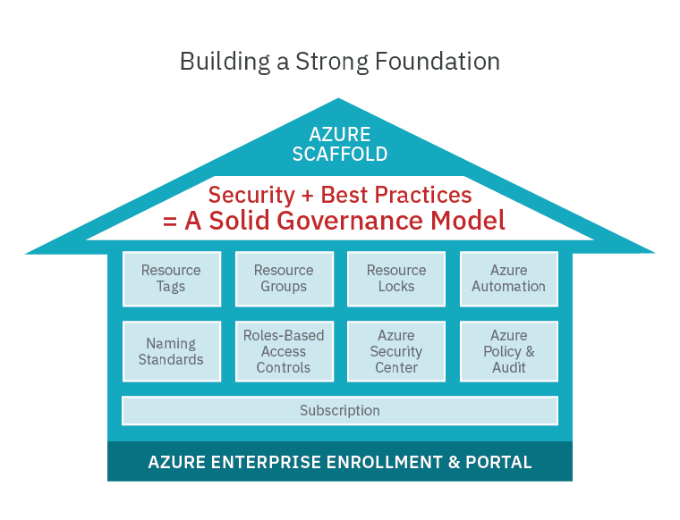

Slide 12
Azure Governance Architecture
providing control over the cloud environment, without sacrificing developer agility
Policy Definitions
Role-based Access
ARM Templates
Management Groups
Azure Portal
CLI
3rd party
Environment Factory: Deploy and update cloud environments in a repeatable manner using composable artifacts
Subscriptions
CRUD
Query
Azure Blueprints
Policy Engine
Azure Resource Graph
Azure Resource Manager (ARM)
2. Policy-based Control: Real-time enforcement, compliance assessment and remediation at scale
3. Resource Visibility: Query, explore & analyze cloud resources at scale
Virtual Machine
Storage
Network
…
Resource Provider

Slide 13
The Landscape
Azure Security

Slide 14
Rising costs
1
The security landscape
!
Increasing complexity
!
!
Evolving threats
!
!
On-premises
Cloud
Talent gap

Slide 15
$$$
!
!
!
!
!

Slide 16
Strengthen security posture with Azure 3 Core components of Azure security model
Unique Intelligence
Detect new threats and respond rapidly
Microsoft Azure
Built-in Controls
Simplify security, protect hybrid workloads quickly
Secure Foundation
Reduce costs with Microsoft managed infrastructure

Slide 17

Secure Foundation
Microsoft managed
Physical datacenter
Global datacenters
Multi-layered protection
Industry leading compliance
Azure infrastructure
Microsoft Azure
Custom hardware & innovation
Network infrastructure protection (e.g DDoS)
Continuous testing
Operational security-
Restricted access to customer data for Microsoft
24x7 monitoring
3500+ Global security-experts
Notes:
Platform has two sides of the coin. The first side is the secure foundation of our cloud services. This is about how we operate our own cloud services, Azure, Office 365 and so forth. We have some of the world's best physical security, with fences and barbed wire and so on to provide secured building environments and within those buildings, secure server environments.
To enter a server environment, for example, a person would have to pass through multiple physical layers and provide multiple forms of identification. They would also be scanned for metal in their pockets to make sure that they are not bringing devices in to steal information. So, there's a great deal of physical security in place that we do on behalf of all of our customers in our cloud services and that make it possible for our customers to really leverage the investment that we've made in that respect.
Operational security I touched on a minute ago when we talked about the human piece of the Intelligent Security Graph. One of the ways this comes to life is in our continual testing of our services, making sure that that we're finding vulnerabilities faster than the bad guys can. We have a big focus on red team, blue team exercises. If you're not familiar with those, the idea is that we have dedicated professionals whose job it is to be on the good side but act like the bad guys—they’re constantly trying to find ways to penetrate the services, find ways that hackers might attack us so that we can shore up our defenses.
Another example of our operational excellence is around restricted access. When Microsoft employees need elevated access so that they can do maintenance on a service, or so they can investigate a customer support issue, they only have access to exactly the resources they need to access and for only exactly the amount of time that they need it. So, they have just in time and just enough access to do their work, and then they get out. They don't have any standing elevated access that allows them to view customer data.
And this is something, again, where we can make an investment at Microsoft that gets heavily leveraged because all of our customers benefit.
Lastly, customer controls are a huge important part of this. This is something that we get asked about a lot when we talk to customers about our cloud services. What are the things that I have at my control so that I can decide how I want to manage my data and access to it? Access controls, of course, are the very foundation of it. Multi-factor authentication for admins at customer sites who are in charge of operating Azure for that customer or operating Office 365. Having multi-factor authentication of course is a basic that we think is fundamental.
The encryption and key management capabilities that are in place allow customers to decide how and where they want to encrypt data at rest and in transit, and it allows them to be in possession of the encryption keys so that they know there's no way that anybody at Microsoft, even there were a rogue bad actor inside of our organization somehow, they would not be able to access that customer data because it's encrypted with a key that the customer holds.
And lastly, network and distributed denial of service protection is in place for all of these services. We do basic protection to ensure our services work reliably, and Azure customers can take advantage of additional protection at the network layer to suit their needs.

Slide 18
Built-in Controls
Defense-in-depth strategies
1
Identity & access management
Data protection
Microsoft Azure
Network security
Integrated partner solutions
Advanced threat protection
Security management

Slide 19

Unique Intelligence
Integrated with Microsoft services
Machine learning
Threat intelligence
Microsoft Azure
Behavior analytics
Notes:
Platform has two sides of the coin. The first side is the secure foundation of our cloud services. This is about how we operate our own cloud services, Azure, Office 365 and so forth. We have some of the world's best physical security, with fences and barbed wire and so on to provide secured building environments and within those buildings, secure server environments.
To enter a server environment, for example, a person would have to pass through multiple physical layers and provide multiple forms of identification. They would also be scanned for metal in their pockets to make sure that they are not bringing devices in to steal information. So, there's a great deal of physical security in place that we do on behalf of all of our customers in our cloud services and that make it possible for our customers to really leverage the investment that we've made in that respect.
Operational security I touched on a minute ago when we talked about the human piece of the Intelligent Security Graph. One of the ways this comes to life is in our continual testing of our services, making sure that that we're finding vulnerabilities faster than the bad guys can. We have a big focus on red team, blue team exercises. If you're not familiar with those, the idea is that we have dedicated professionals whose job it is to be on the good side but act like the bad guys—they’re constantly trying to find ways to penetrate the services, find ways that hackers might attack us so that we can shore up our defenses.
Another example of our operational excellence is around restricted access. When Microsoft employees need elevated access so that they can do maintenance on a service, or so they can investigate a customer support issue, they only have access to exactly the resources they need to access and for only exactly the amount of time that they need it. So, they have just in time and just enough access to do their work, and then they get out. They don't have any standing elevated access that allows them to view customer data.
And this is something, again, where we can make an investment at Microsoft that gets heavily leveraged because all of our customers benefit.
Lastly, customer controls are a huge important part of this. This is something that we get asked about a lot when we talk to customers about our cloud services. What are the things that I have at my control so that I can decide how I want to manage my data and access to it? Access controls, of course, are the very foundation of it. Multi-factor authentication for admins at customer sites who are in charge of operating Azure for that customer or operating Office 365. Having multi-factor authentication of course is a basic that we think is fundamental.
The encryption and key management capabilities that are in place allow customers to decide how and where they want to encrypt data at rest and in transit, and it allows them to be in possession of the encryption keys so that they know there's no way that anybody at Microsoft, even there were a rogue bad actor inside of our organization somehow, they would not be able to access that customer data because it's encrypted with a key that the customer holds.
And lastly, network and distributed denial of service protection is in place for all of these services. We do basic protection to ensure our services work reliably, and Azure customers can take advantage of additional protection at the network layer to suit their needs.

Slide 20
Built-in Controls | Identity and access management
Manage and control user identity and access
Extend on-premises directory to the cloud/same sign-on/single sign-on
Azure Active Directory Connect
1
2
Use principle of least privilege
Azure Role Based Access Control
Azure Active Directory Conditional Access based policy
1
3
Enable additional identity protection
Configure Multi-factor authentication
Monitor and control privileged accounts with Azure AD PIM
Enable additional threat protection with Azure AD Identity Protection
Notes:
Azure AD Connect will integrate your on-premises directories with Azure Active Directory. This allows you to provide a common identity for your users for Office 365, Azure, and SaaS applications integrated with Azure AD.
Role-based Access Control. Azure Roles-Based Access Control (RBAC) enables fine-grained access management for Azure. Using RBAC, you can segregate duties within your devops team and grant only the amount of access to users that they need to perform their jobs.
Azure Active Directory Conditional Access is a capability of Azure Active Directory that enables you to enforce controls on the access to apps in your environment based on specific conditions from a central location. Sign in Risk, Network Location, Device Management, client application.
Azure multi-factor authentication is a method of verifying who you are that requires the use of more than just a username and password. Using MFA for Office 365, users are required to acknowledge a phone call, text message, or app notification on their smart phones after correctly entering their passwords.
AAD Privileged Identity Management – see which users are assigned priv roles, enabled JIT admin access to O365 and Intune and Az subs, history of changes made by admins, require approval for admin roles, provide view into priv roles and require justification for maintaining roles
AAD Identity Protection – detect vulns affecting organizations identities, configure automatic response to suspicious actions that are related to your organizations identities, investigate suspicious incidents and take action to resolve them. Azure Active Directory uses adaptive machine learning algorithms and heuristics to detect anomalies and suspicious incidents that indicate potentially compromised identities. Using this data, Identity Protection generates reports and alerts that enable you to evaluate the detected issues and take appropriate mitigation or remediation actions.

Slide 21

Built-in Controls | Data protection
Encrypt data and communications
Enable built-in encryption across resources
Azure Storage Service Encryption
Azure Disk Encryption
SQL TDE/Always Encrypted
VIRTUAL MACHINES
APPLICATIONS
STORAGE & DATABASES
1
2
Configure firewalls
Azure SQL database firewall
Azure Storage Firewall
Host and virtual network appliance-based firewalls
1
3
Use delegated access to storage objects
Shared Access Signature enables more granular access control
4
Use a key management system
Keep keys in a hardware HSM/don’t store key in apps/GitHub
Use one Key Vault per security boundary/per app/per region
Monitor/audit key usage-pipe information into SIEM for analysis/threat detection
Use Key Vault to enroll and automatically renew certificates
Key & Certificate Management- Azure Key Vault
Notes:
Data encryption controls are built into services from virtual machines
to storage and SQL database.
As data moves between clouds and customers, data can be protected
using industry-standard encryption protocols.
Azure Key Vault enables users to safeguard and control cryptographic
keys and other secrets used by cloud apps and services.
Azure Information Protection will help classify, label, and protect your
sensitive data in apps.
===================
Key Vault best practices:
Use a key management system
Use hardware-based Hardware Security Modules (HSMs) to store keys and secrets/don’t store them in source code in GitHub
Grant applications access to stored keys – don’t let applications manage the keys
Audit and monitor key usage, and pipe that information into your SIEM for analysis and threat detection
Use the key management system to enroll and automatically renew certificates to prevent service downtime
Use 1 key vault per security boundary. Typically that means 1 key vault per app per region.
Prepare upfront for the bad events. Enable logs. Enable soft delete. Rehearse key/secret rotation.
For best security, reduce humans and extra hops in the flow of secrets. Secrets must go directly from source->key vault->final destination.

Slide 22

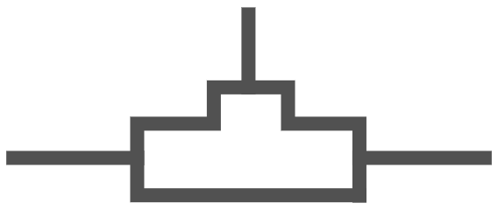
Built-in Controls | Network security
Strengthen network access controls
Configure network access rules, segmentation
Set-up appropriate Network security group (NSG) or Application security group rules
Use Virtual Network Appliance to enable additional filtering
1
Network security groups
VPN
2
Avoid exposure to the Internet with dedicated WAN links
Use Site to site VPN
Azure ExpressRoute
1
3
Enable additional protections to ensure application availability
Use Application Gateway & Web Application Firewall
Configure DDoS Protection Standard
WAF
Web Application Firewall
DDoS Protection
Notes:
Data encryption controls are built into services from virtual machines
to storage and SQL database.
As data moves between clouds and customers, data can be protected
using industry-standard encryption protocols.
Azure Key Vault enables users to safeguard and control cryptographic
keys and other secrets used by cloud apps and services.
Azure Information Protection will help classify, label, and protect your
sensitive data in apps.

Slide 23
Built-in Controls | Advanced threat protection
Protect workloads against evolving attacks
Mitigate potential vulnerabilities proactively
Ensure up to date VMs with relevant security patches
Enable host anti-malware
VIRTUAL MACHINES
APPLICATIONS
STORAGE & DATABASES
NETWORK
1
Reduce surface area of attack
Enable just in time access to management ports
Configure Application Whitelisting to prevent malware execution
2
1
3
Detect threats early and respond faster
Use actionable alerts and incidents
Interactive investigation tool and playbooks to orchestrate responses
Azure Security Center
with advanced analytics for threat detection
Notes:
Data encryption controls are built into services from virtual machines
to storage and SQL database.
As data moves between clouds and customers, data can be protected
using industry-standard encryption protocols.
Azure Key Vault enables users to safeguard and control cryptographic
keys and other secrets used by cloud apps and services.
Azure Information Protection will help classify, label, and protect your
sensitive data in apps.

Slide 24
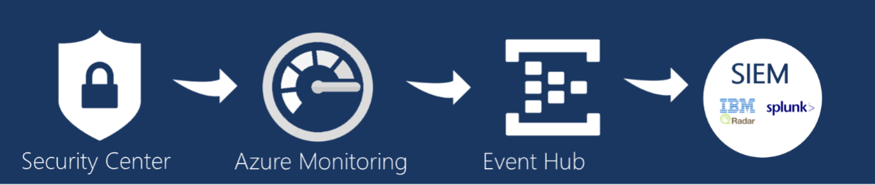
Built-in Controls | Advanced threat protection
Enable visibility and control across hybrid workloads
Enable centralized view of security state across cloud and on-premises workloads
Configure automatic provision of agents for Azure resources
Deploy agent to onboard hybrid workloads
VIRTUAL MACHINES
APPLICATIONS
STORAGE & DATABASES
NETWORK
1
Ensure compliance to your requirements
Configure centralized security policy
2
1
3
Integrate auditing, logging with existing processes
Configure auditing, logging and use Log Analytics for advanced analysis
Export security data to existing SIEM solutions
Unified visibility and control
Azure Security Center
Notes:
Data encryption controls are built into services from virtual machines
to storage and SQL database.
As data moves between clouds and customers, data can be protected
using industry-standard encryption protocols.
Azure Key Vault enables users to safeguard and control cryptographic
keys and other secrets used by cloud apps and services.
Azure Information Protection will help classify, label, and protect your
sensitive data in apps.

